Slide 1
Task 2: Requirement Gathering
Design and Implementation of a Mobile App for Collection of User Experience Data from Mobile Network Subscribers
CEF440 Internet Programming and Mobile Programming
Stakeholder identification
Techniques used
Data gathering
Data cleaning
User reluctance assessment
Presenter 1
1

Slide 2
Why Requirement gathering is critical for our project
Understand who the app is for and what each stakeholder needs
Collect real network experience data from mobile subscribers
Identify feature expectations, data-sharing limits, and trust issues
Prepare clean input for requirement analysis and SRS
Survey responses
93 valid form submissions
Main output
Usable requirements for design
Next step
Analyze and formally document gatherings using use case diagrams
Presenter 1
2

Slide 3
Stakeholder identification
Primary stakeholders
Secondary stakeholders
Subscribers
Provide QoE feedback and usage context
Network analysts
Interpret patterns and problem areas
App admin
Manages records, permissions and support
Lecturer / assessors
Evaluate project method and deliverables
Telecom operators
Use collected insight for optimisation
Regulators / researchers
Potential long-term users of aggregated insights
Presenter 2
3

Slide 4
Requirement gathering techniques used
Survey questionnaire
Main technique Used to reach many subscribers quickly
Group brainstorming
Helped refine questions, features and scope
Review of similar apps
Guided what data, alerts and reports to ask for
Primary method in this phase: Google Forms survey
Structured questions + exportable CSV for analysis
Presenter 2
4

Slide 5
Data gathering process
1
Design survey Questions on usage, network issues, concerns and features
2
Distribute form Shared with mobile network subscribers
3
Collect responses 93 responses captured through Google Forms
4
Export dataset Responses exported as CSV for cleaning and summary
Question areas: profile, usage, network experience, sharing, preferences
Presenter 3
5

Slide 6
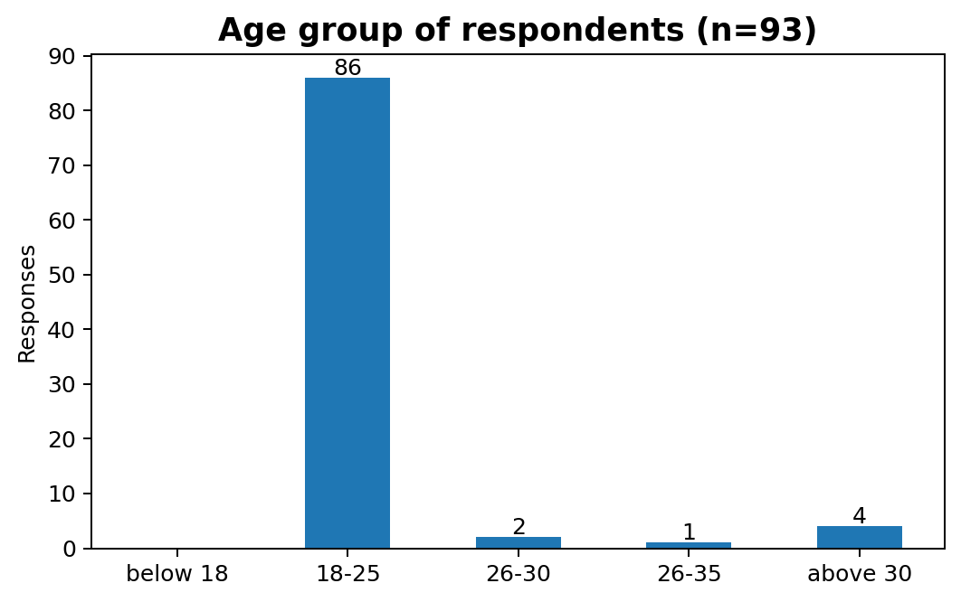
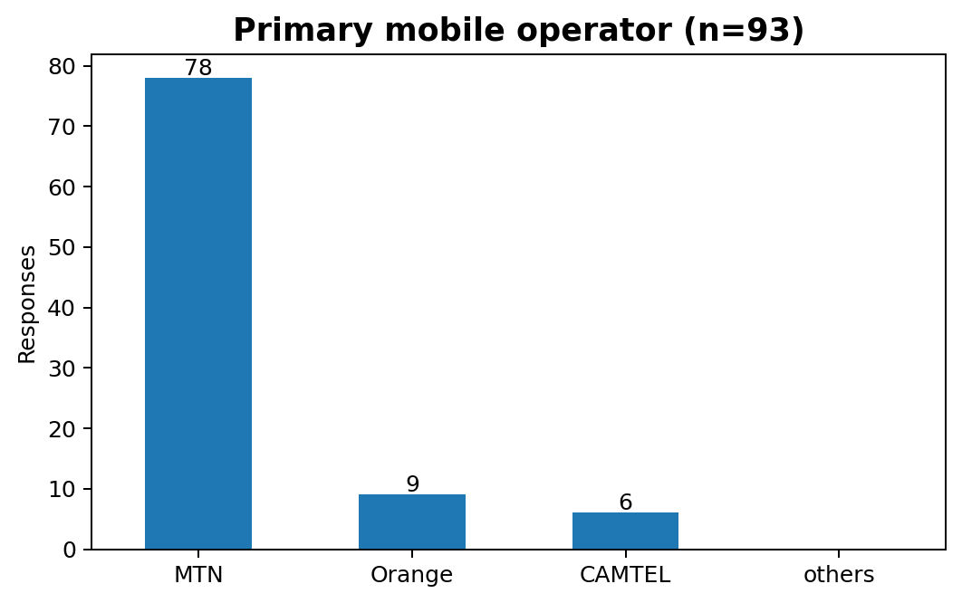
Survey Review and Analysis
Occupation
81 of 93 respondents were students
Operating system
51 Android, 42 iOS
Usage intensity
90 respondents use mobile internet frequently
Presenter 3
6

Slide 7
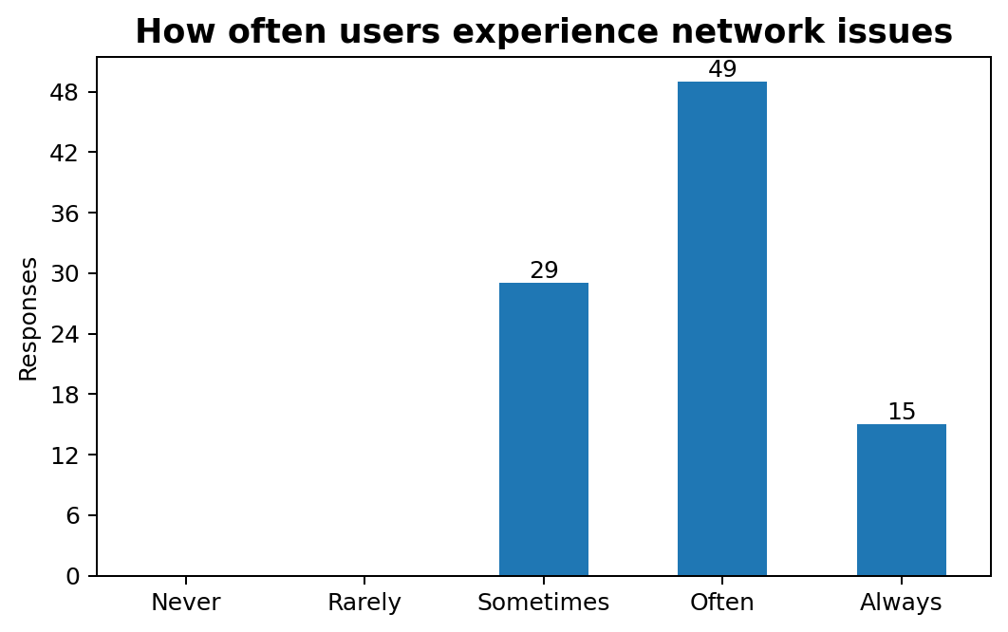
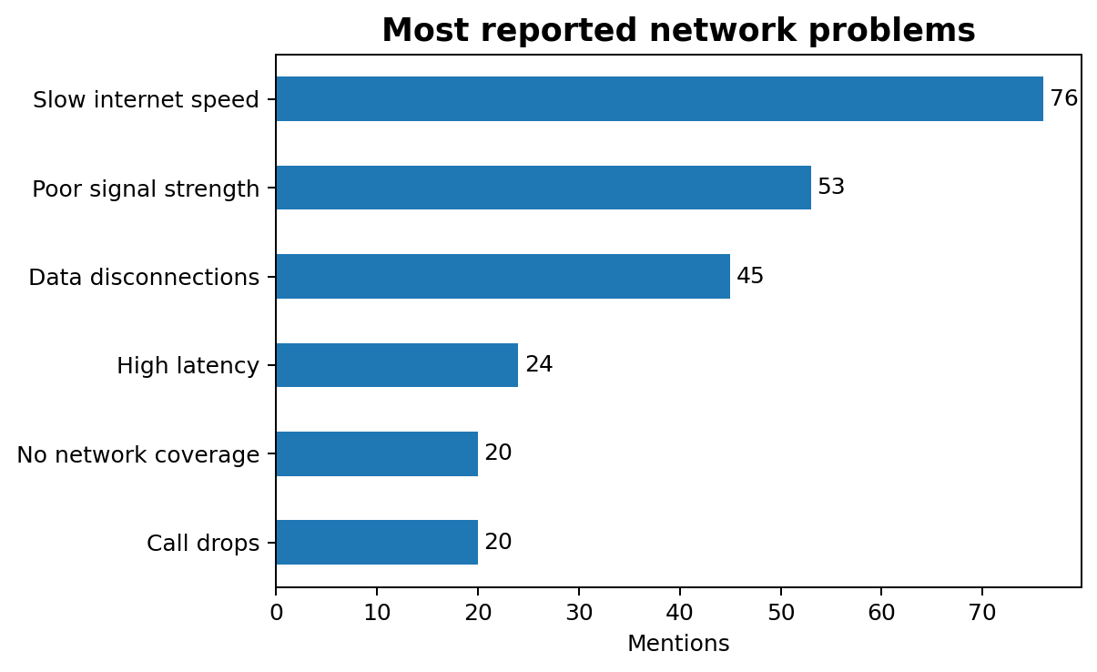
What users reported
Main takeaway
Network problems are common; slow internet speed and poor signal strength dominate the user experience.
Presenter 4
7

Slide 8
Data cleaning carried out
Inspect export
Checked columns, missing responses and inconsistent labels
Tidy structure
Renamed stray column, removed irrelevant spacing, reviewed blanks
Prepare analysis
Split multi-select answers into countable categories
Summarise output
Converted raw responses into charts and key findings
Examples from the dataset
Unnamed gender column, mixed response formats needed cleanup before interpretation.
Presenter 4
8

Slide 9
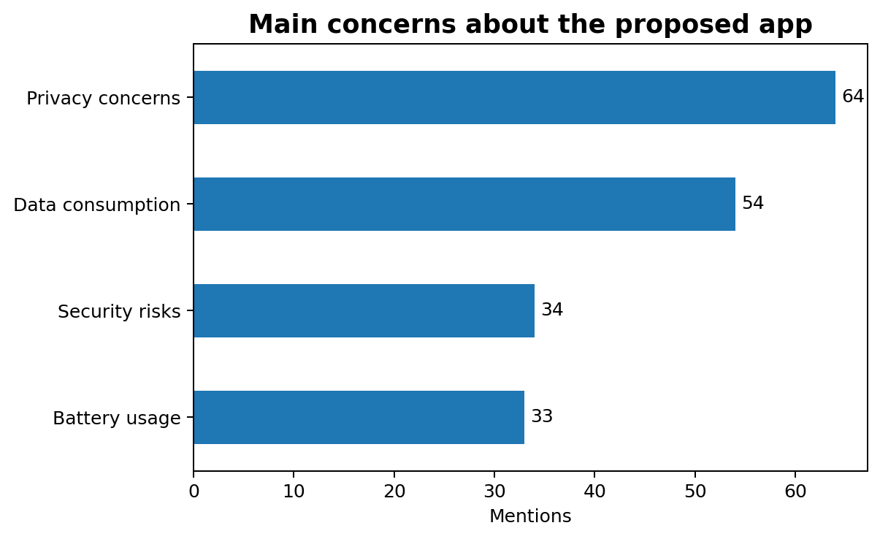
User reluctance assessment
Automatic data collection
27 yes • 60 maybe • 6 no
Periodic notifications
39 yes • 43 maybe • 11 no
Location sharing*
19 yes • 16 maybe • 18 no
*53 respondents answered this question.
Presenter 5
9

Slide 10
Conclusion and final judgment
Transparent permissions
Users want clear control over data collection
Low-friction feedback
Prompts should be limited and preferably issue-based
Useful user value
Reports, alerts and live performance views matter
What does this means for our subsequent task?
Requirements can now be analysed, classified, prioritised and documented
Presenter 5
10

